Slide 1
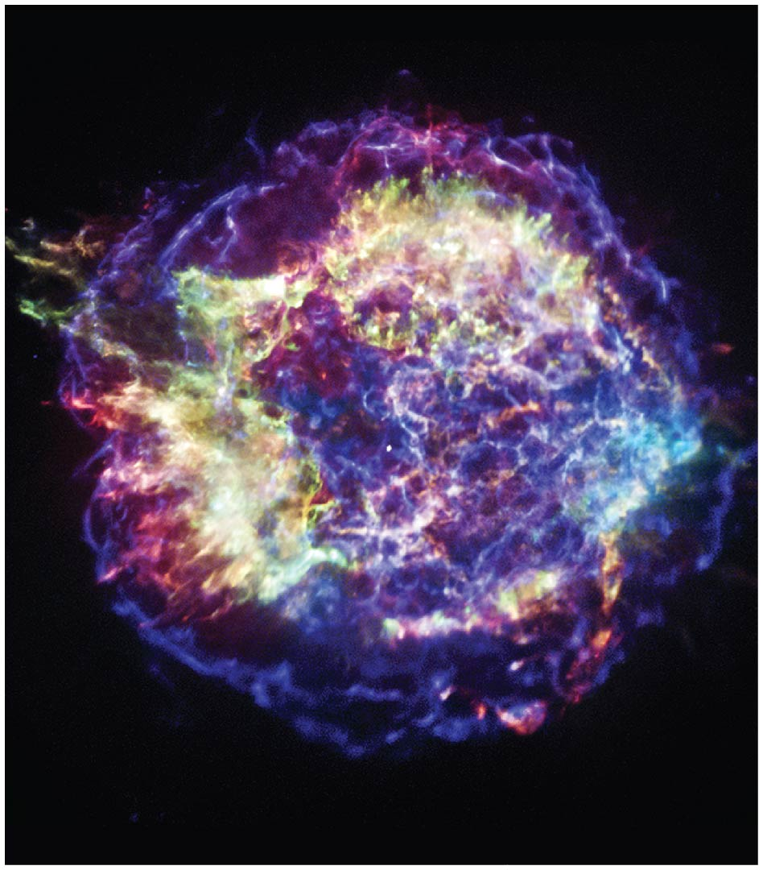
Neutron Stars and Black Holes

Slide 2
Units of Chapter
Neutron Stars
Pulsars
Neutron Star Binaries
Gamma-Ray Bursts
Black Holes
Einstein’s Theories of Relativity
Space Travel Near Black Holes
Observational Evidence for Black Holes
Summary of Chapter 13

Slide 3
Neutron Stars
After a Type I supernova, little or nothing remains of the original star.
After a Type II supernova, part of the core may survive. It is very dense—as dense as an atomic nucleus—and is called a neutron star.
https://www.youtube.com/watch?v=ZW3aV7U-aik

Slide 4

13.1 Neutron Stars
Neutron stars, although they have 1–3 solar masses, are so dense that they are very small. This image shows a 1-solar-mass neutron star, about 10 km in diameter, compared to Manhattan.

Slide 5
Neutron star interior
https://www.youtube.com/watch?v=YOXVMmPX4No

Slide 6
When the core of a star begins to collapse in the absence of nuclear reactions, its density increases and attains a value comparable to the density of white dwarfs. The degeneracy pressure due to electrons can balance the gravitational contraction only when the mass of the object is smaller than the Chandrasekhar limit. If the mass is more than this limiting value, the gravitational collapse continues and the density of the star increases further. When the density is in the range ~ 10^14 − 10^15 g cm −3 , the following two things happen:
a) protons and electrons combine to produce neutrons and neutrinos according to the following inverse β-decay reaction: e + p → n + v
b) atomic nuclei begin to disintegrate due to pressure ionisation.

Slide 7
Is there any limiting mass for neutron stars similar to the Chandrasekhar limit for white dwarfs?
Yes; but the precise value of the limiting mass for the stars is difficult to determine because the behaviour of matter at such high densities is not well understood yet. The estimated limiting mass is in the range 2 – 3 MΘ

Slide 8
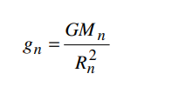
How strong is its gravitational pull?
Estimate the value of gravitational acceleration, g, on a neutron star, say, of mass Mn ~ 1.5MΘ and radius Rn ~ 10 km
Substituting the values of Mn and Rn, we get, gn ~ 2 × 10^14 cm s^ −2 . The value of gn is ~ 2 × 10^11 times higher than the gravitational acceleration on the Earth! That is, the gravitational force on a neutron star is 10^11 times stronger than that due to the Earth.

Slide 9
Gravitational Red-shift of Neutron Stars
Suppose you are standing on the surface of the star which is emitting a yellow light at λ = 5800 Angstrom . The light reaches your eyes approximately one metre above the ground. The interesting question is: Will you see the light as yellow?
A photon leaving the surface of the neutron star has energy hν and equivalent mass hν/c^2 . The neutron star will attract this photon and, as a result, the photon has to work ‘hard’ against the star’s gravity to reach your eyes (just as a stone thrown upward from the earth slows down as it goes higher)
https://www.youtube.com/watch?v=cNpKMn9aV9g

Slide 10
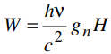
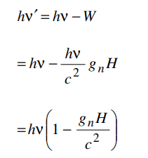
The work done by the photon to reach your eye is
W = mgh
mass equivalent of a photon = E/ c^2
Energy of photon E = h neu
Now, to arrive at your eyes, the photon works against gravity and hence its energy, that is, frequency will decrease and wavelength will increase. To calculate the change in wavelength or frequency, we can use the energy conservation principle,
(λ prime – λ )/ λ

Slide 11
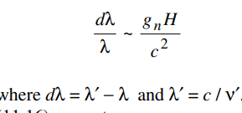
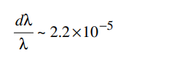
Substituting the values of gn, c and H,

Slide 12
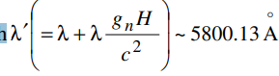
Thus, yellow light of wavelength λ = 5800 Angstrom leaving your feet (the surface of the neutron star) will arrive at your eyes as light of wavelength
The increase in the wavelength of a photon when it comes out of a strong gravitational field is called gravitational red-shift.

Slide 13
The significance of this phenomenon lies in the fact that scientists must make necessary corrections in the observed frequency of photon presumably coming from objects such as neutron stars in order to understand physical processes on their surface.

Slide 14
13.1 Neutron Stars
Other important properties of neutron stars (beyond mass and size):
Rotation—As the parent star collapses, the neutron core spins very rapidly, conserving angular momentum. Typical periods are fractions of a second.
Magnetic field—Again as a result of the collapse, the neutron star’s magnetic field becomes enormously strong.

Slide 15
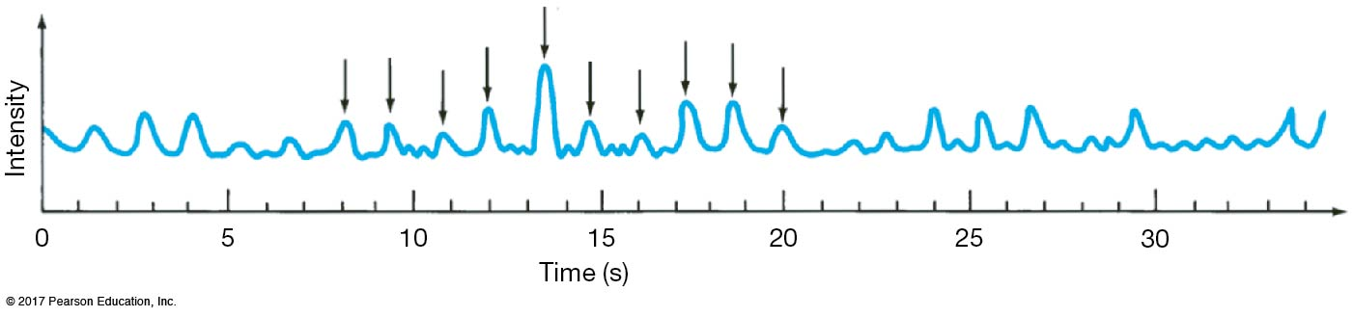
Pulsars
The first pulsar was discovered in 1967. It emitted extraordinarily regular pulses; nothing like it had ever been seen before.
After some initial confusion, it was realized that this was a neutron star, spinning very rapidly.

Slide 16
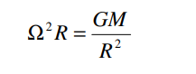
How can we be sure that a strong pulse, whose periodicity is about a second, is emitted by a neutron star and not by a white dwarf or any other star?
When a star rotates, each of its layers experiences centrifugal force directed outward as well as the pointing gravitational force directed inward. If Ω be the angular velocity and R be the radius of the rotating star, the two forces balance in a Keplerian orbit and we can write:

Slide 17
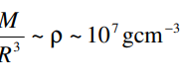
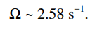
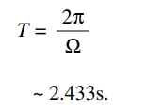
For a white dwarf,
it is clear that for objects with lower densities, the corresponding Ω will also be lower, and hence the time period would be higher! Therefore, white dwarfs and other bigger celestial objects are too big, their densities are too low and they cannot emit pulses with periods as short as those observed in pulsars

Slide 18
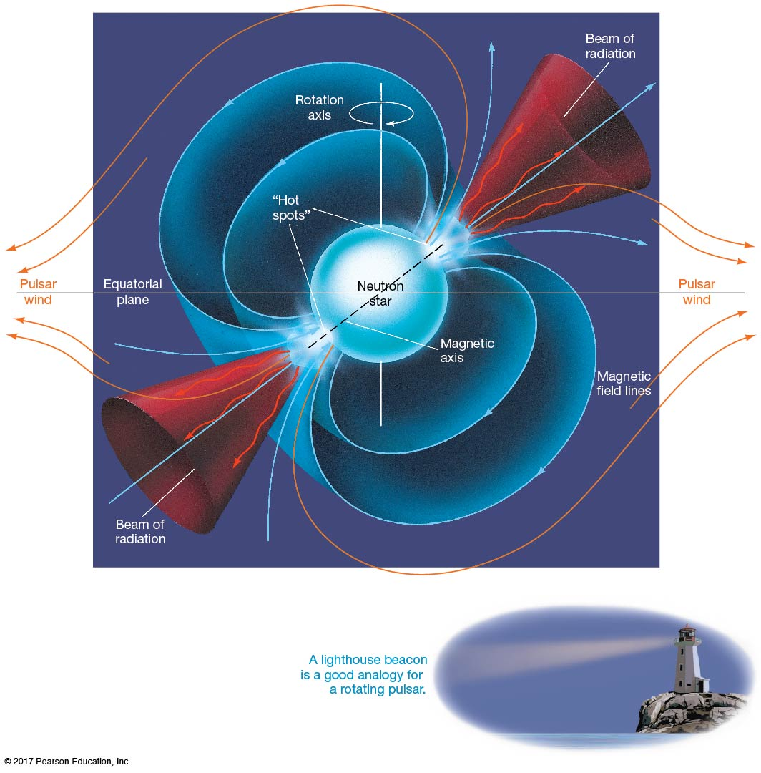
13.2 Pulsars
But why would a neutron star flash on and off? This figure illustrates the lighthouse effect responsible.
Strong jets of matter are emitted at the magnetic poles, as that is where they can escape. If the rotation axis is not the same as the magnetic axis, the two beams will sweep out circular paths.
If Earth lies in one of those paths, we will see the star blinking on and off.

Slide 19
13.2 Pulsars
Pulsars radiate their energy away quite rapidly; the radiation weakens and stops in a few tens of millions of years, making the neutron star virtually undetectable.
Pulsars also will not be visible on Earth if their jets are not pointing our way.

Slide 20
What causes emission of pulses from a neutron star?
It is suggested that a neutron star is like a gigantic light house. In a light house, a powerful light-source rotates and ships see it periodically. In exactly the same way, emission of radiation takes place continuously, but due to rotation of the neutron star the emission is detected only periodically by an observer on the Earth

Slide 21
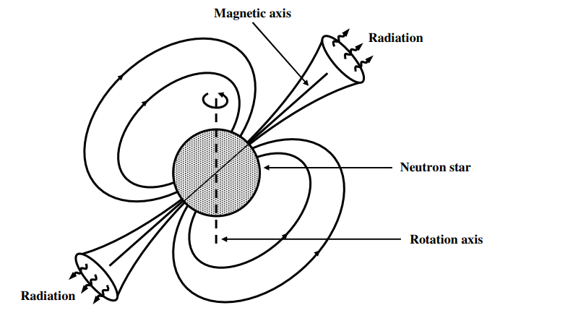

Slide 22
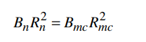
How strong is magnetic field of pulsars?
Suppose a molecular cloud of radius, Rmc ~ 1 pc having a typical magnetic field, Bmc ~ 10^-6G collapses into a neutron star of size, Rn ~ 10 km. if the matter is highly conducting, the magnetic flux linked to it is conserved:
B r ^2 ~ constant

Slide 23
Substituting the typical values of Rn, Bmc and Rmc, we get: Bn ~ 9.5 × 10^18 G.
Thus, we find that the value of magnetic field associated with a neutron star is very high compared to the Earth’s magnetic field which is only a fraction of Gauss.

Slide 24
As the neutron star spins at great speeds, its magnetic field induces a very strong electric field. As a result, electrons present in the atmosphere of the neutron star are accelerated and attain very high energies. These electrons then gyrate round the magnetic lines of force and emit radiation called synchrotron radiation which is directed along the lines of force. Every time the neutron star rotates, each of the two radiating magnetic poles may point towards us (Fig.) and we may see two pulses of radiation per rotation of the star.

Slide 25
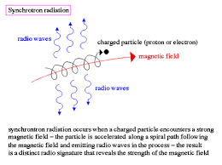
Synchrotron radiation is the electromagnetic radiation emitted when charged particles travel in curved paths. Because in most accelerators the particle trajectories are bent by magnetic fields, synchrotron radiation is also called Magneto-Bremsstrahlung

Slide 26
The electromagnetic radiation comes from accelerated charged particles, mainly electrons and positrons.
The surface of a neutron star is not made of neutrons. It is a totally ionised gas of nuclei plus electrons, with a composition that could range from iron-peak elements to hydrogen and helium accreted from the interstellar medium.
As a result of their rotation and strong dipolar magnetic fields then there are also very strong electric fields at the surface of the neutron star. These fields rip electrons and protons from the surface and accelerate them away - electrons from the magnetic poles and protons at lower magnetic latitudes. The classic work on this is by Julian & Goldreich (1969).
The acceleration due to these electric fields is easily sufficient to overcome gravity. The particles are forced to spiral along the magnetic field lines by the Lorentz force, and produce synchrotron or curvature radiation directly. The photons from these processes are then capable of creating secondary electron-positron pairs that are accelerated in opposite directions, releasing more photons in a cascade.
No neutrons are harmed in the making of this radiation, other than the ones in nuclei at the surface of the neutron star that get bombarded by high energy accelerated electrons and positrons.

Slide 27
Suppose the Sun shrinks to the size of a neutron star of radius 10^6 cm. Calculate the magnetic field strength at the surface of the neutron star. Take the radius of the Sun to be 10^11 cm and the magnetic field at its surface equal to 1 gauss.

Slide 28
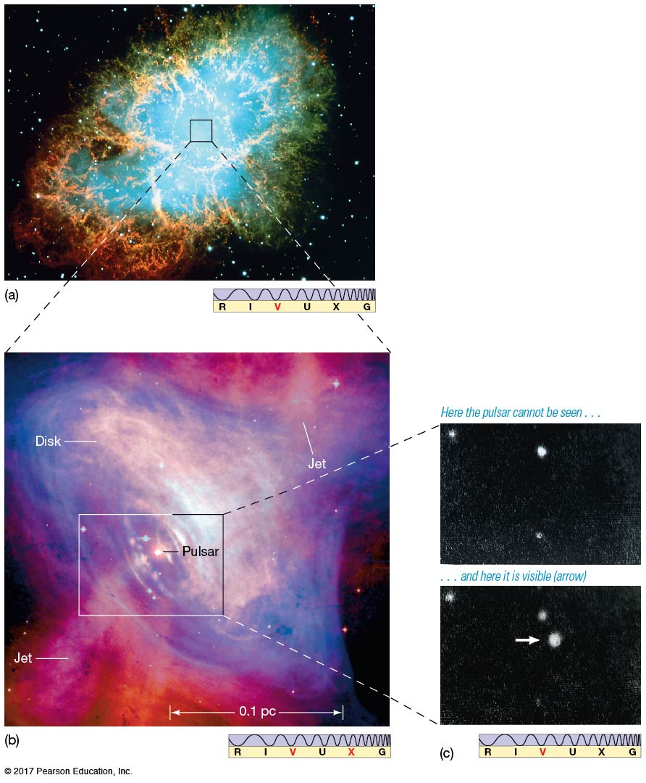
13.2 Pulsars
There is a pulsar at the center of the Crab Nebula; the images to the right show it in the “off” and “on” positions.

Slide 29
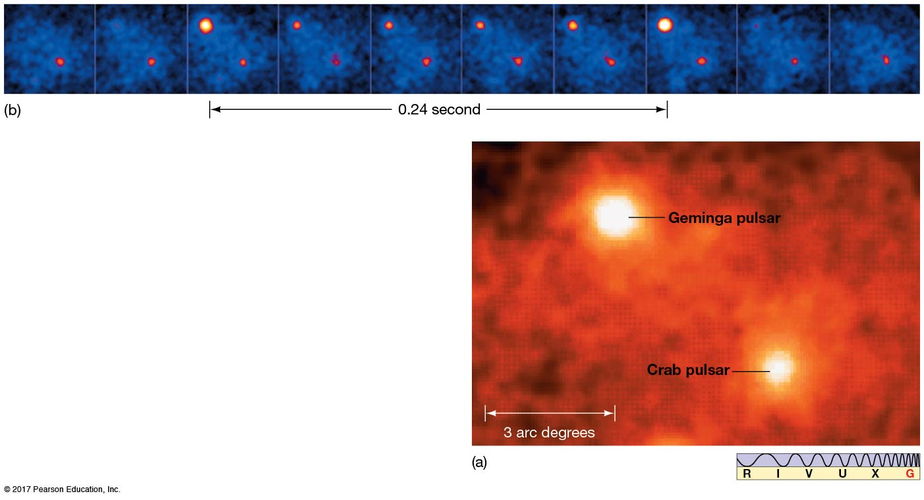
13.2 Pulsars
The Crab pulsar also pulses in the gamma-ray spectrum, as does the nearby Geminga pulsar.

Slide 30
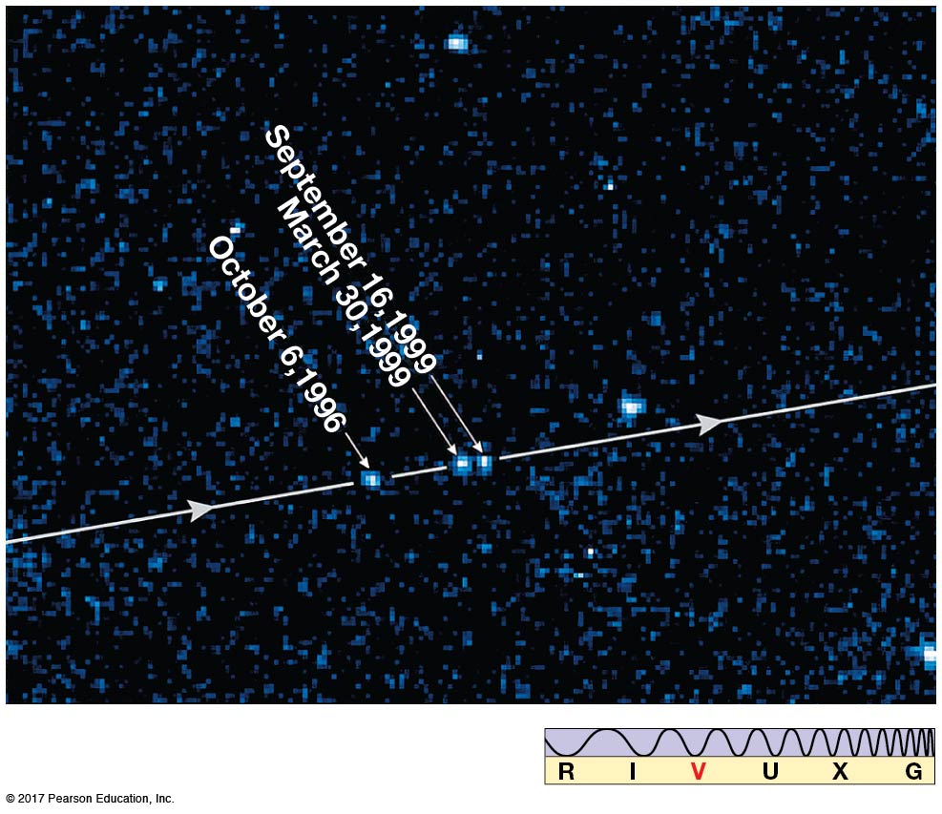
13.2 Pulsars
An isolated neutron star has been observed by the Hubble telescope; it is moving rapidly, has a surface temperature of 700,000 K, and is about 1 million years old.

Slide 31
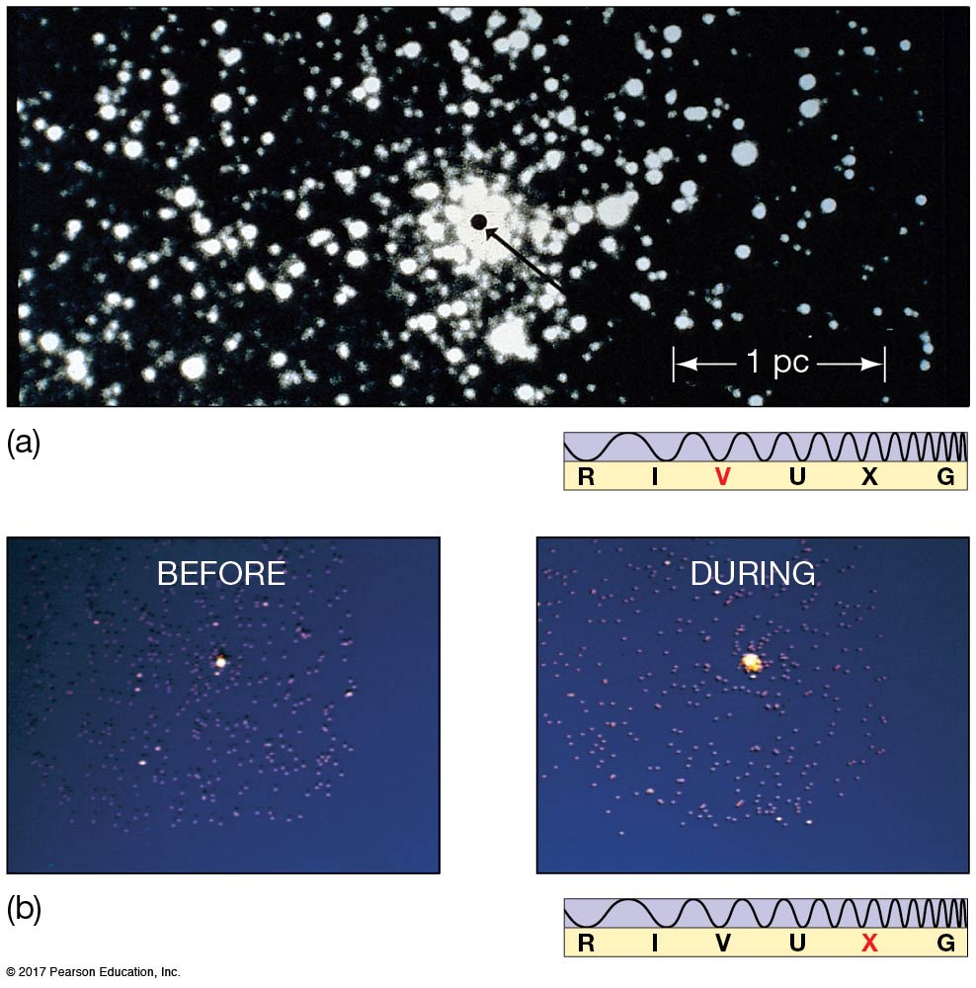
13.3 Neutron Star Binaries
Bursts of X-rays have been observed near the center of our Galaxy. A typical one appears at right, as imaged in the X-ray spectrum.

Slide 32
13.3 Neutron Star Binaries
These X-ray bursts are thought to originate on neutron stars that have binary partners.
The process is very similar to a nova, but much more energy is emitted due to the extremely strong gravitational field of the neutron star.

Slide 33
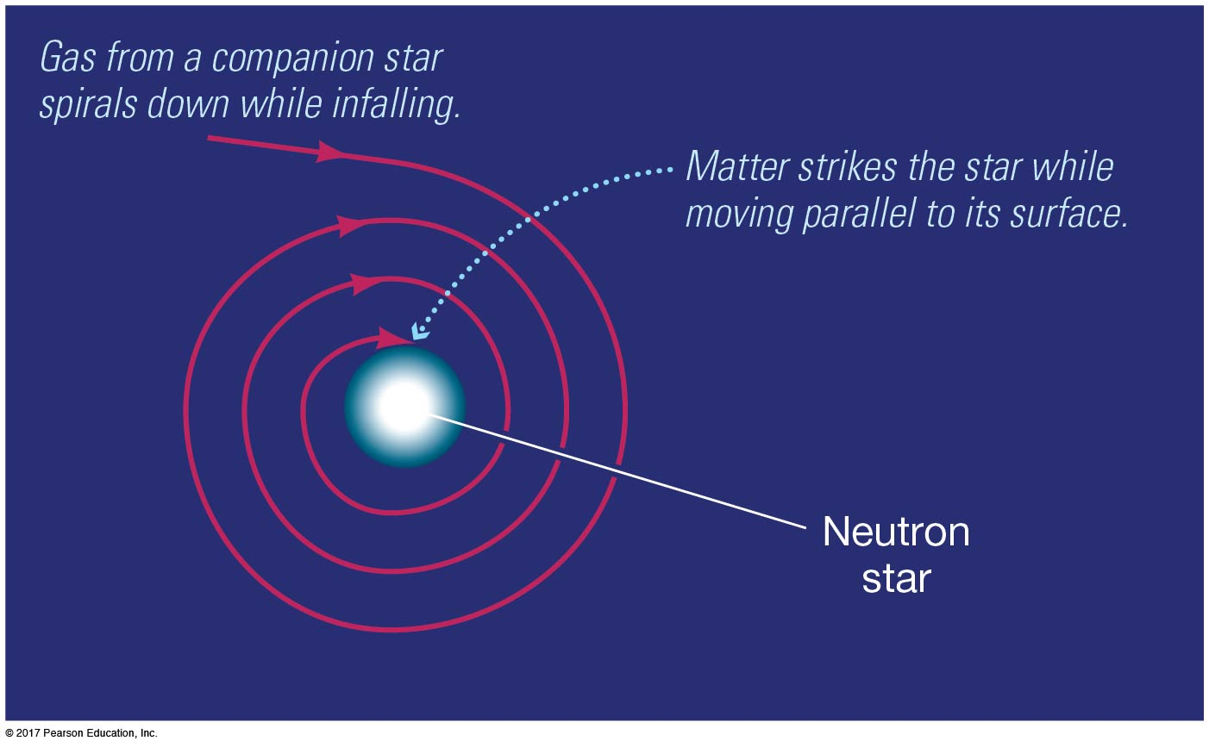
13.3 Neutron Star Binaries
Most pulsars have periods between 0.03 and 0.3 seconds, but a new class of pulsar was discovered in the early 1980s: the millisecond pulsar.

Slide 34
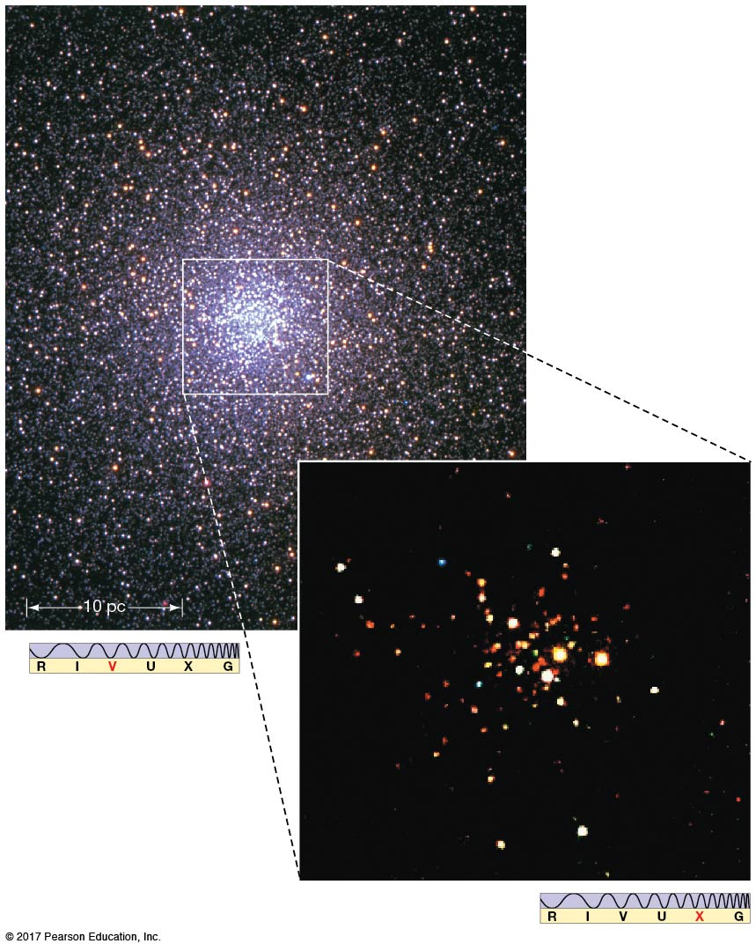
13.3 Neutron Star Binaries
Millisecond pulsars are thought to be “spun-up” by matter falling in from a companion.
This globular cluster has been found to have 108 separate X-ray sources, about half of which are thought to be millisecond pulsars.

Slide 35
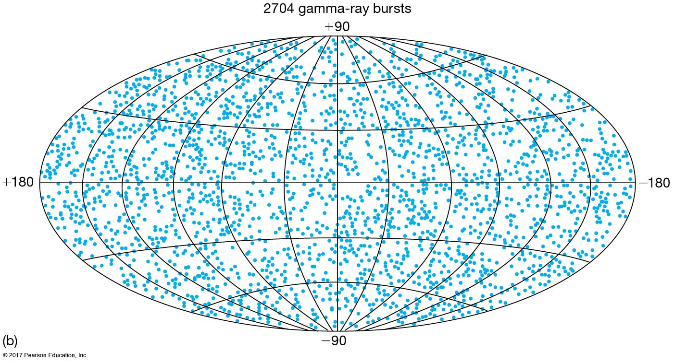
13.4 Gamma-Ray Bursts
Gamma-ray bursts also occur and were first spotted by satellites looking for violations of nuclear test-ban treaties. This map of where the bursts have been observed shows no “clumping” of bursts anywhere, particularly not within the Milky Way. Therefore, the bursts must originate from outside our Galaxy.

Slide 36
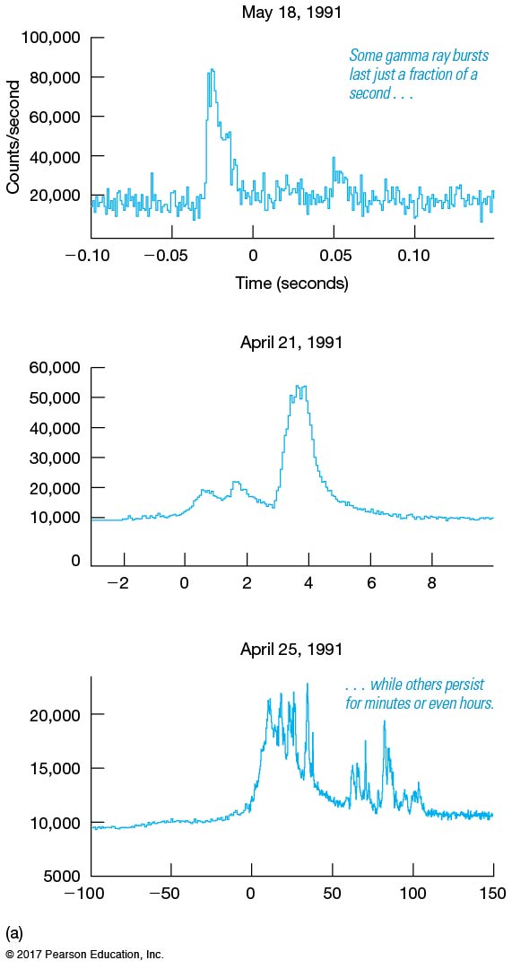
13.4 Gamma-Ray Bursts
These are some sample curves plotting gamma-ray intensity versus time for gamma-ray bursts.

Slide 37
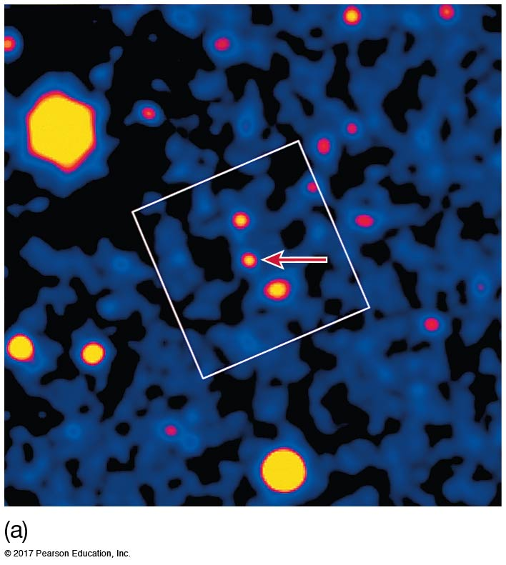
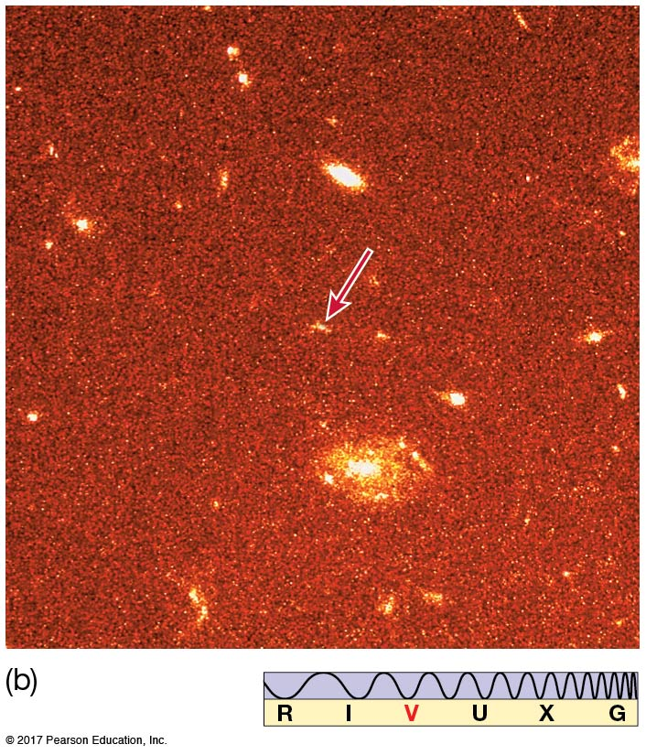
13.4 Gamma-Ray Bursts
Distance measurements of some gamma bursts show them to be very far away—2 billion parsecs for the first one measured.
Occasionally, the spectrum of a burst can be measured, allowing distance determination.

Slide 38
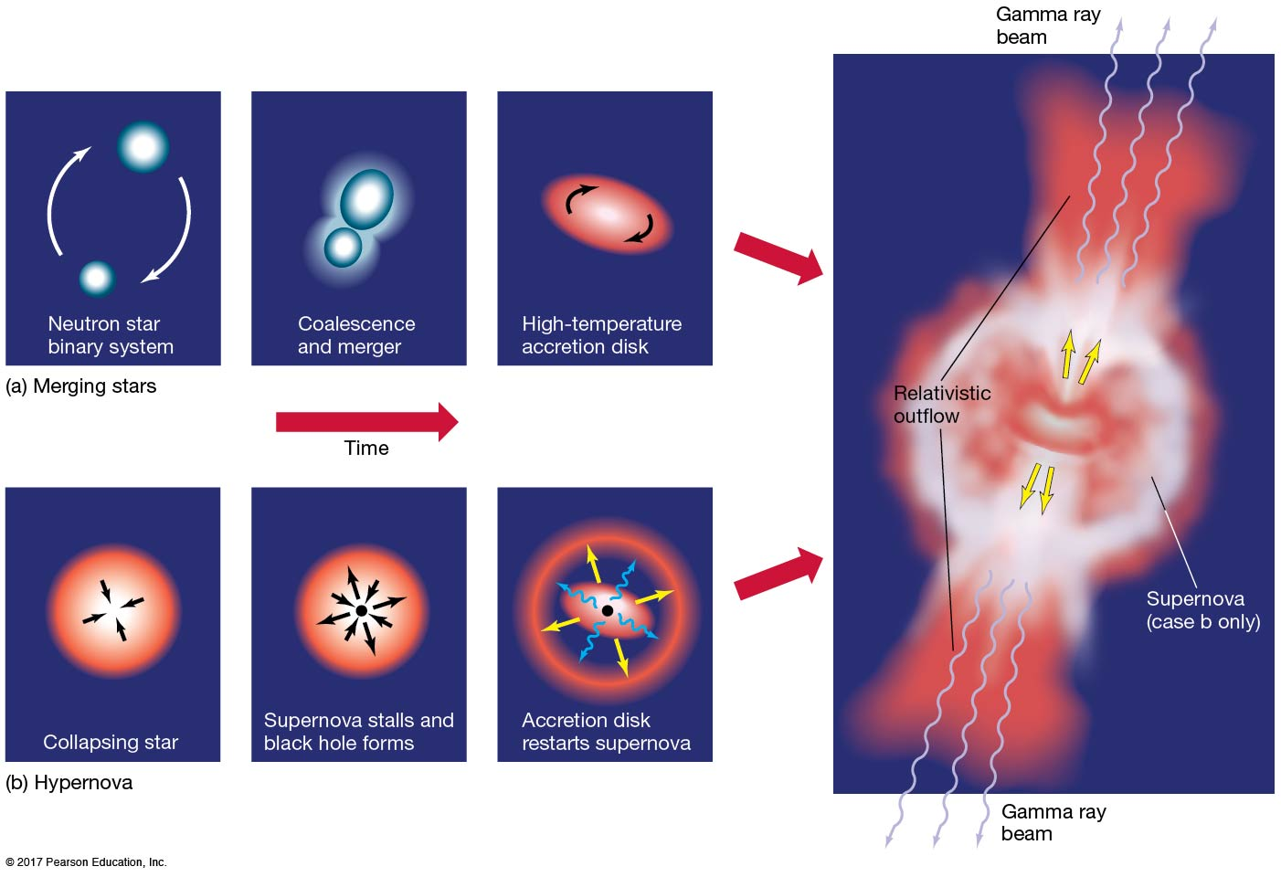
13.4 Gamma-Ray Bursts
Two models—merging neutron stars or a hypernova—have been proposed as the source of gamma-ray bursts.

Slide 39
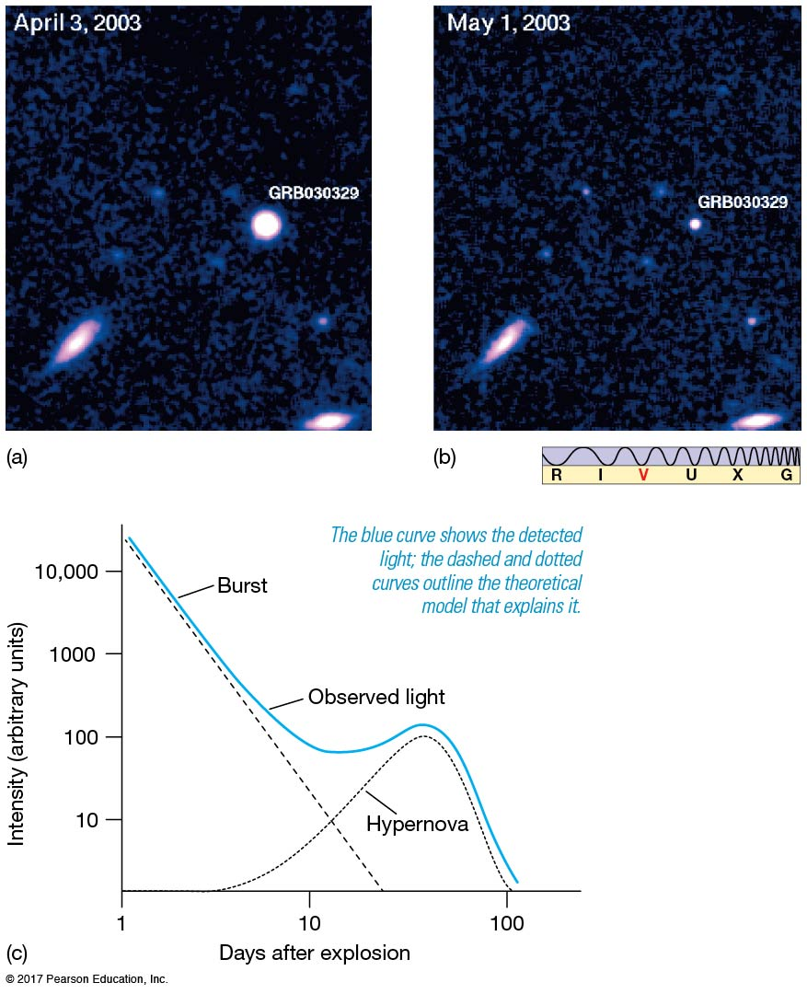
13.4 Gamma-Ray Bursts
This burst looks very much like an exceptionally strong supernova, lending credence to the hypernova model.

Slide 40
Pulsars

Slide 41
13.5 Black Holes
The mass of a neutron star cannot exceed about 3 solar masses. If a core remnant is more massive than that, nothing will stop its collapse, and it will become smaller and smaller and denser and denser.
Eventually, the gravitational force is so intense that even light cannot escape. The remnant has become a black hole.

Slide 42
13.5 Black Holes
The radius at which the escape speed from the black hole equals the speed of light is called the Schwarzschild radius.
Earth’s Schwarzschild radius is about a centimeter; the Sun’s is about 3 km.
Once the black hole has collapsed, the Schwarzschild radius takes on another meaning: It is the event horizon. Nothing within the event horizon can escape the black hole.

Slide 43
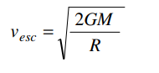
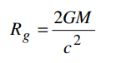
Schwarzschild radius
Since we are interested in a black hole and trapping of light by it, we put v_esc = c, the velocity of light,

Slide 44
Calculate the Schwarzschild radius, in centimeters, for Earth where M = 5.7 x 1027 grams. (Express answer to two significant figures)
Calculate the Schwarzschild radius, in kilometers, for the sun, where M = 1.98 x 1033 grams. (Express answer to two significant figures)
Calculate the Schwarzschild radius, in kilometers, for the entire Milky Way, with a mass of 250 billion suns. (Express answer to two significant figures)
Calculate the Schwarzschild radius, in centimeters, for a black hole with a mass of an average human being with M = 60 kilograms. (Express answer to two significant figures)

Slide 45
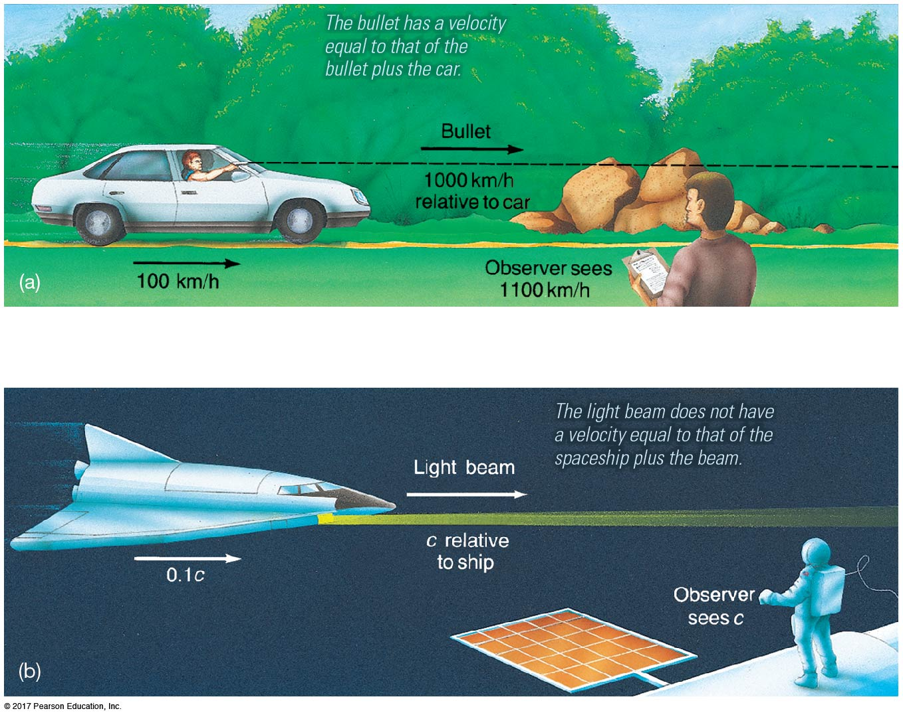
13.6 Einstein’s Theories of Relativity
Special relativity:
The speed of light is the maximum possible speed, and it is always measured to have the same value by all observers.

Slide 46
13.6 Einstein’s Theories of Relativity
There is no absolute frame of reference and no absolute state of rest.
Space and time are not independent, but rather are unified as spacetime.

Slide 47
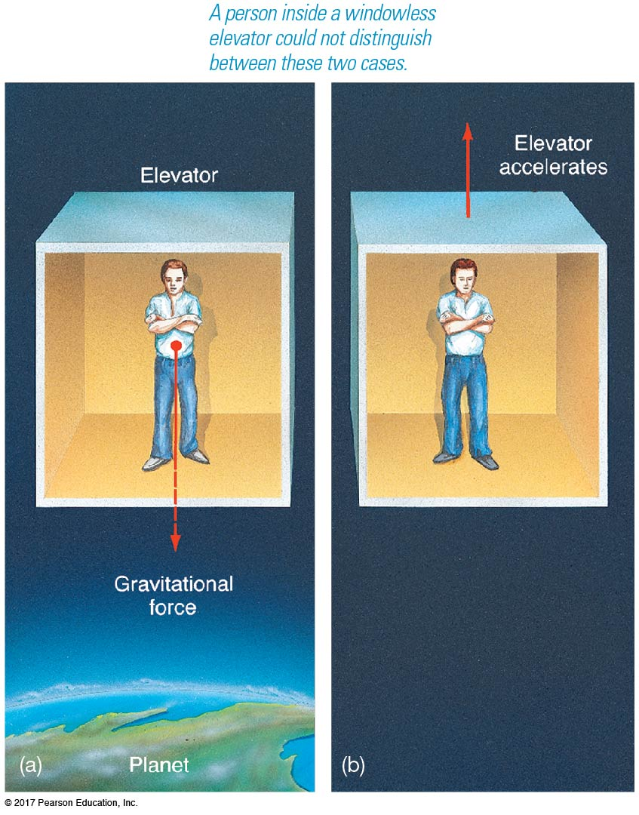
13.6 Einstein’s Theories of Relativity
General relativity:
It is impossible to tell, from within a closed system, whether one is in a gravitational field or accelerating.

Slide 48
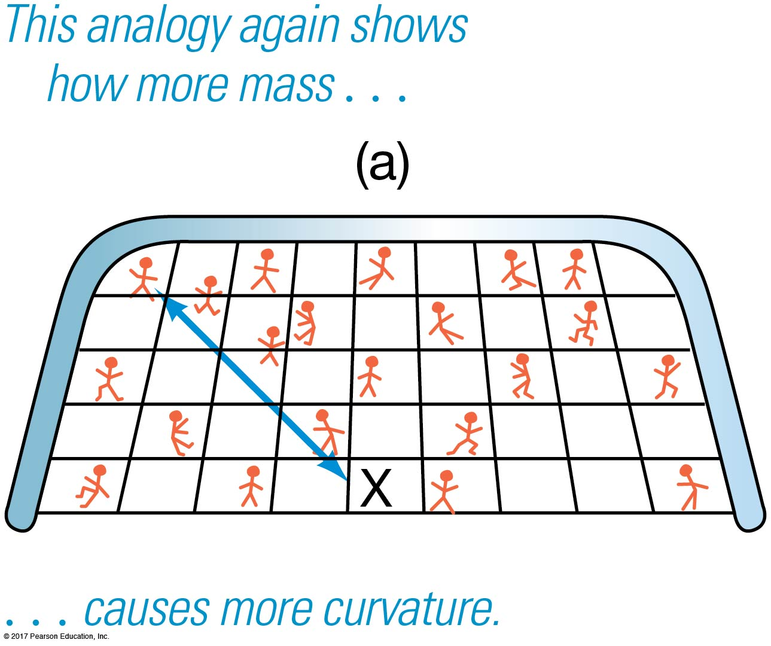
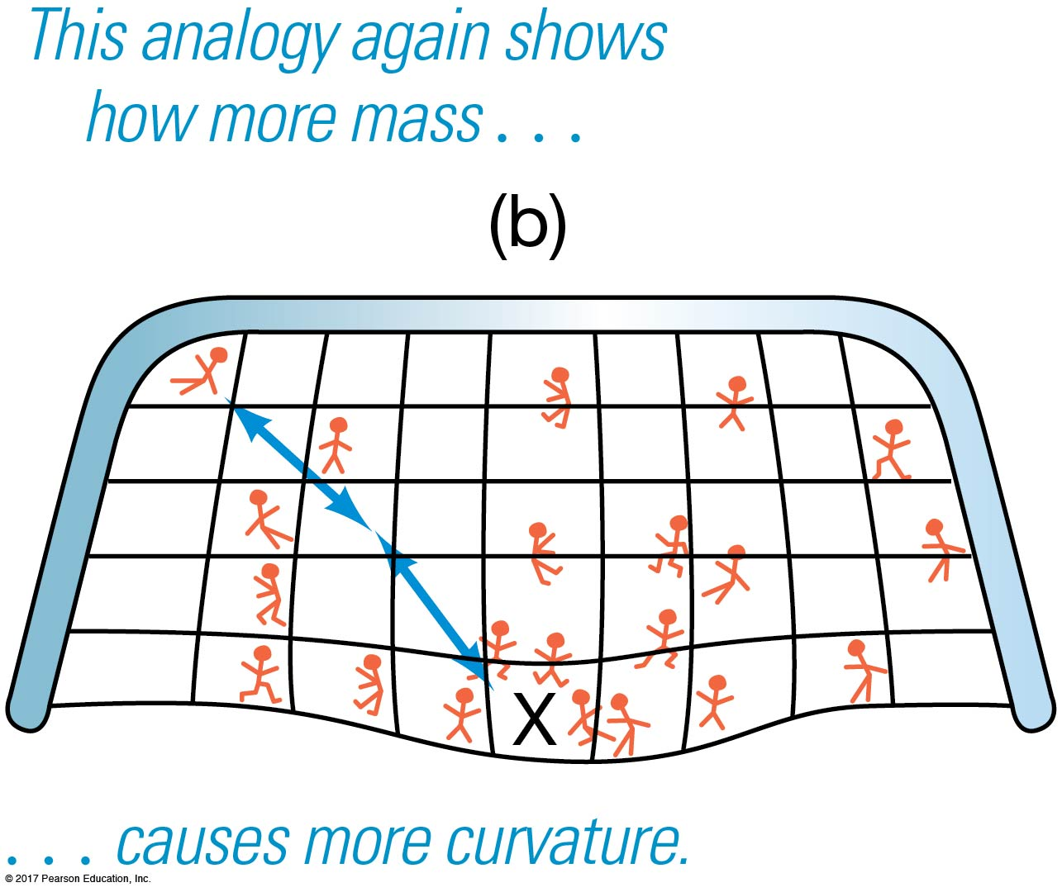
13.6 Einstein’s Theories of Relativity
Matter tends to warp spacetime, and in doing so redefines straight lines (the path a light beam would take).
A black hole occurs when the “indentation” caused by the mass of the hole becomes infinitely deep.

Slide 49
13.7 Space Travel Near Black Holes
The gravitational effects of a black hole are unnoticeable outside of a few Schwarzschild radii. Black holes do not “suck in” material any more than an extended mass would.

Slide 50
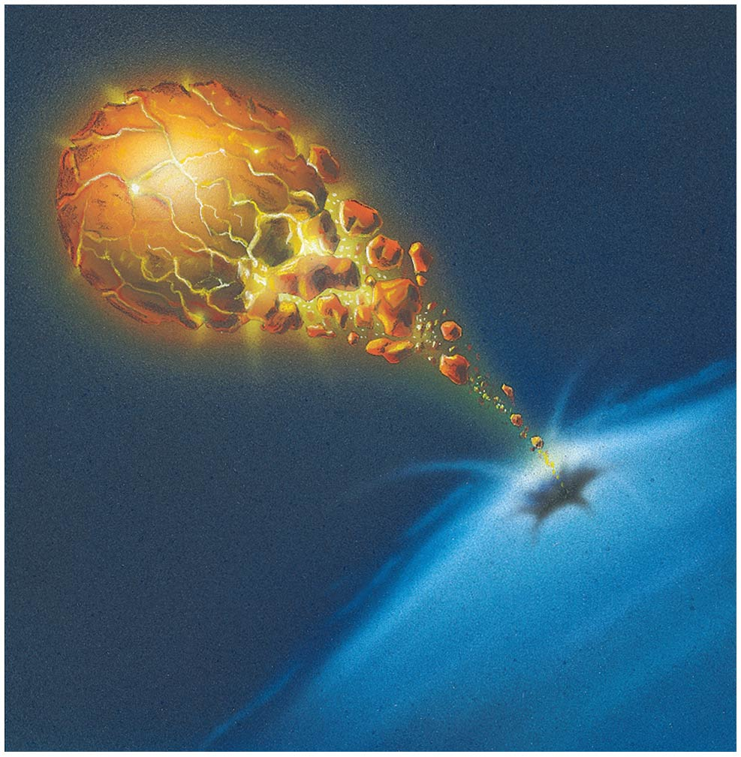
13.7 Space Travel Near Black Holes
Matter encountering a black hole will experience enormous tidal forces that will both heat it enough to radiate and tear it apart.

Slide 51
13.7 Space Travel Near Black Holes
A probe nearing the event horizon of a black hole will be seen by observers as experiencing a dramatic redshift as it gets closer, so that time appears to be going more and more slowly as it approaches the event horizon.
This is called a gravitational redshift. It is not due to motion, but to the large gravitational fields present.
The probe itself, however, does not experience any such shifts; time would appear normal to anyone inside.

Slide 52
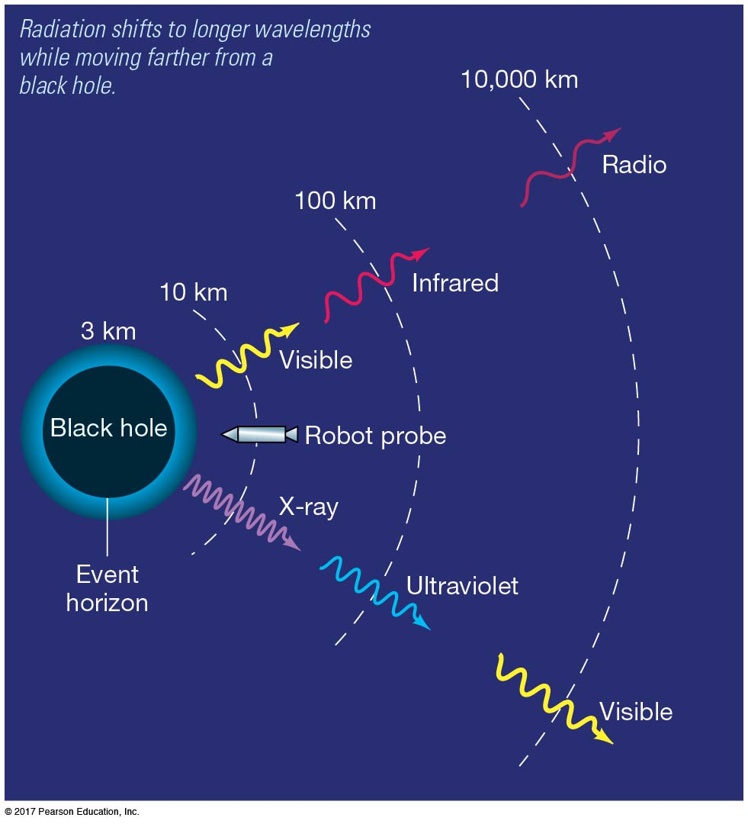
13.7 Space Travel Near Black Holes
Similarly, a photon escaping from the vicinity of a black hole will use up a lot of energy doing so; it can’t slow down, but its wavelength gets longer and longer.

Slide 53
13.7 Space Travel Near Black Holes
What’s inside a black hole?
No one knows, of course; present theory predicts that the mass collapses until its radius is zero and its density is infinite; this is unlikely to be what actually happens.
Until we learn more about what happens in such extreme conditions, the interiors of black holes will remain a mystery.

Slide 54
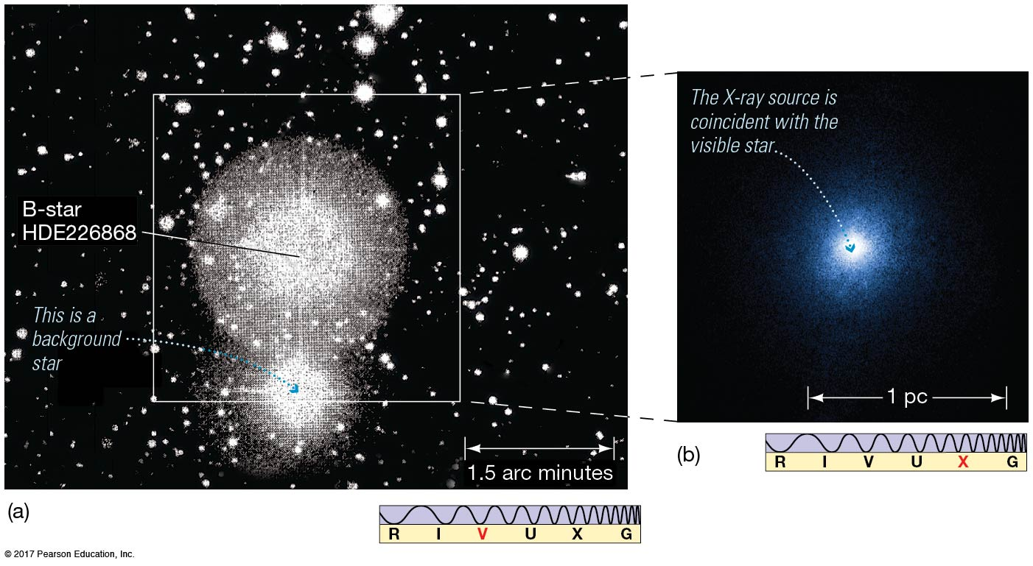
13.8 Observational Evidence for Black Holes
The existence of black hole binary partners for ordinary stars can be inferred by the effect the holes have on the star’s orbit or by radiation from infalling matter.

Slide 55
13.8 Observational Evidence for Black Holes
Cygnus X-1 is a very strong black hole candidate.
Its visible partner is about 25 solar masses.
The system’s total mass is about 35 solar masses, so the X-ray source must be about 10 solar masses.
Hot gas appears to be flowing from the visible star to an unseen companion.
Short timescale variations indicate that the source must be very small.

Slide 56
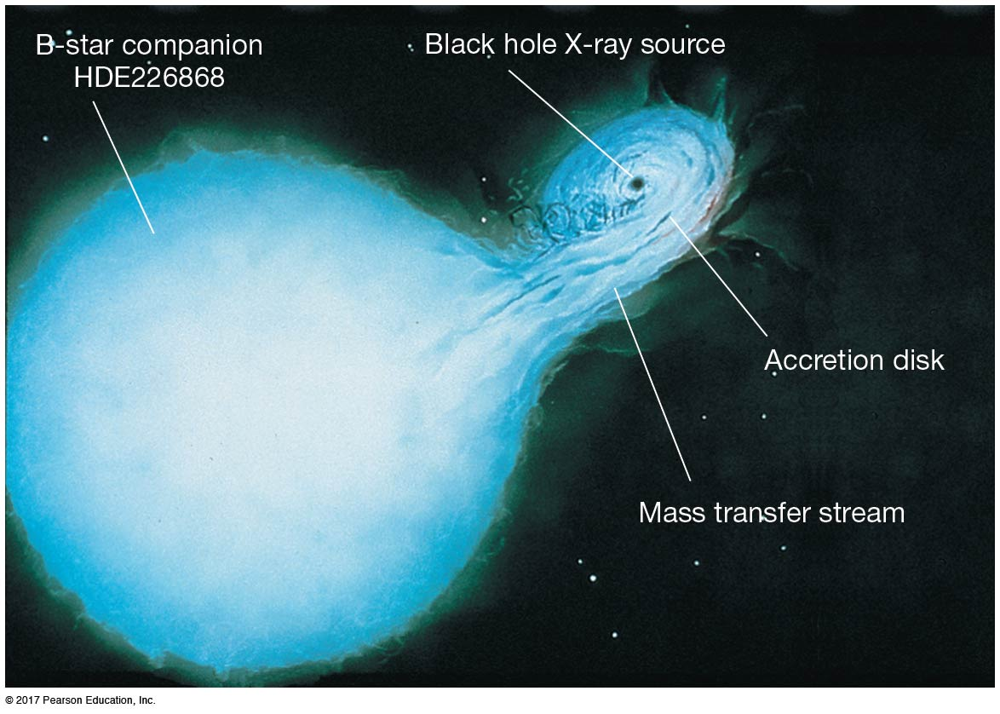
13.8 Observational Evidence for Black Holes
Artist’s conception of the dynamics of the Cygnus X-1 system

Slide 57
13.8 Observational Evidence for Black Holes
There are several other black hole candidates as well, with characteristics similar to Cygnus X-1.
The centers of many galaxies contain supermassive black holes—about 1 million solar masses.

Slide 58
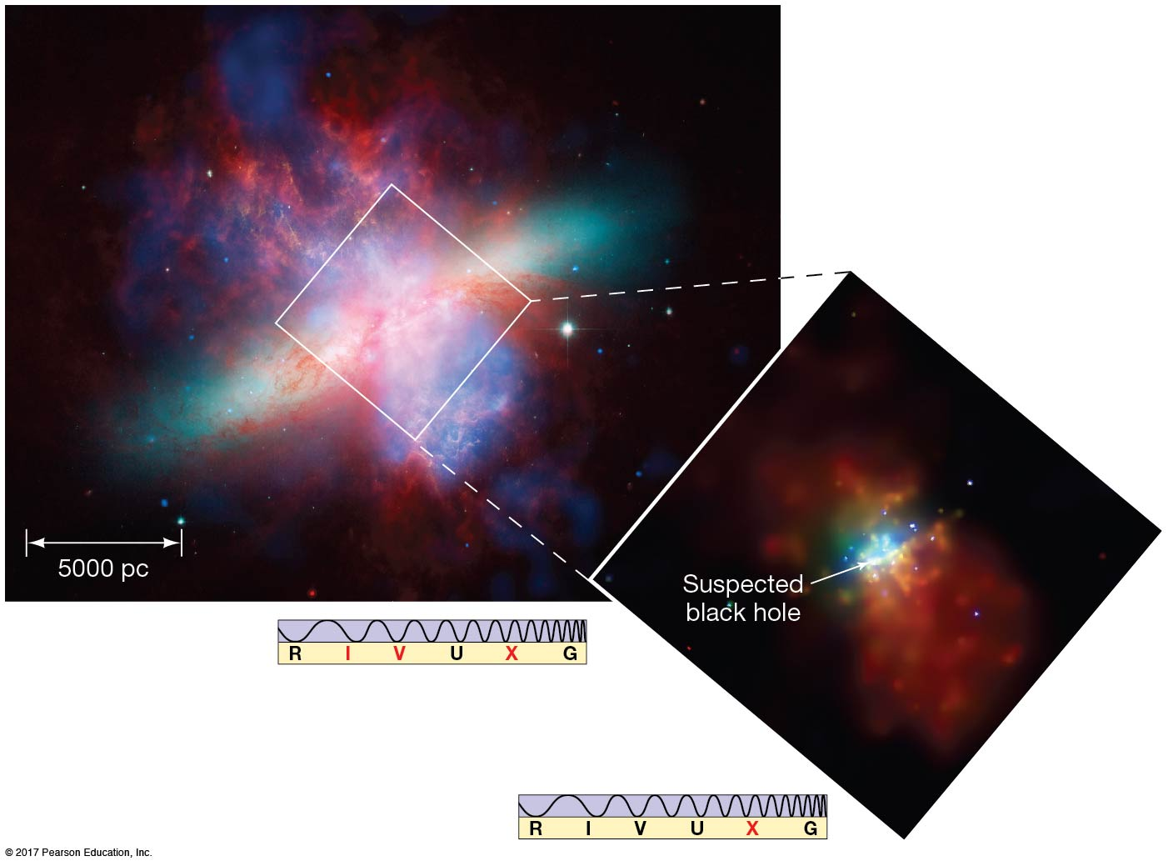
13.8 Observational Evidence for Black Holes
Recently, evidence for intermediate-mass black holes has been found; these are about 100 to 1000 solar masses. Their origin is not well understood.

Slide 59
Summary of Chapter 13
A supernova may leave behind a neutron star.
Neutron stars are very dense, spin rapidly, and have intense magnetic fields.
Neutron stars may appear as pulsars due to the lighthouse effect.
A neutron star in close binary may become an X-ray burster or millisecond pulsar.
Gamma-ray bursts probably are due to two neutron stars colliding, or to hypernova.

Slide 60
Summary of Chapter 13, cont.
If the core remnant is more than about 3 solar masses, it collapses into a black hole.
We need general relativity to describe black holes; it describes gravity as the warping of spacetime.
Anything entering within the event horizon of a black hole cannot escape.
Distance from an event horizon to singularity is the Schwarzschild radius.

Slide 61
Summary of Chapter 13, cont.
Distant observer would see an object entering a black hole to be subject to extreme gravitational redshift and time dilation.
Material approaching a black hole will emit strong X-rays.
A few such X-ray sources have been found and are black hole candidates.

